Slide 1


UNCTAD E-commerce and Digital Economy Measurement Assistance
International Workshop on the Integrated Use of International Trade Statistics and Economic Statistics
24 November 2021
Daniel Ker, E-commerce and Digital Economy Branch
UNCTAD
daniel.ker@un.org

Slide 2
Outline
Context: what is UNCTAD?
Research and analysis on measuring the digital economy
Consensus building on digital economy measurement
Technical assistance in digital economy measurement

Slide 3
Context: what is UNCTAD?
United Nations Conference on Trade and Development
UN body responsible for integrated treatment of economic and sustainable development issues with a focus on trade, finance, investment, and technology
3 Pillars:
  Research and analysis
  Consensus building
  Technical Cooperation
UNCTAD 15 quadrennial conference, October 2020 (Barbados):
  “Strengthen the work on assisting developing countries to systematically assess their state-of-play, readiness to engage and integrate into the digital economy, thus contributing to the closing of the digital divide. In doing so it is important to support the strengthening of the collection and processing of available data in order to produce statistics and policy analysis in relation to the opportunities and challenges of digital economy.” (para 127 (gg))
  https://unctad.org/system/files/official-document/td-l-435_en.pdf

Slide 4
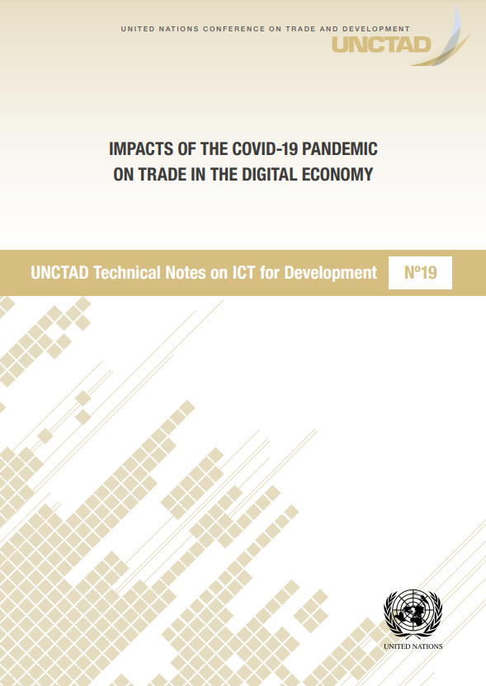
Research and analysis on measuring the digital economy
Monitoring developments in the digital economy
Monitoring and contributing to developments in measurement practice, including:
  ICT sector
  ICT goods and services
  Digitally deliverable services
  Digitalisation of business
  E-commerce
  “Digital trade”
  And others (e.g. measuring data…)

Slide 5
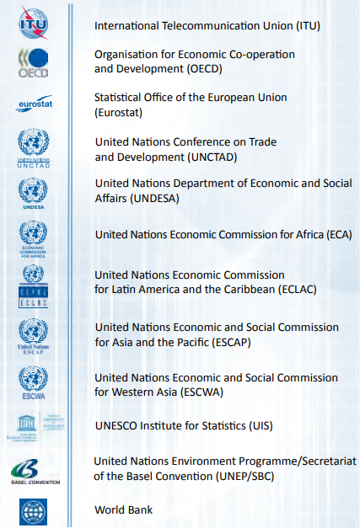
Consensus building in digital economy measurement
Leveraging research and analysis to contribute to consensus building on digital economy measurement
Partnership on Measuring ICT for Development
  Formed in response to a call emanating from the World Summit on the Information Society
  Launched as an outcome of UNCTAD11 (2004), Sao Paulo
  UNCTAD and ITU (+1) as co-leads. Members include other UN bodies and international organisations.
  Developed core ICT indicators and associated statistical standards and methodologies
    Response to call from UN Economic and Social Council
  Worked through Partnership to build consensus at UN Statistical Commission – and formal adoption of the indicators
  Basis for core indicators in the UNCTAD Manual

Slide 6
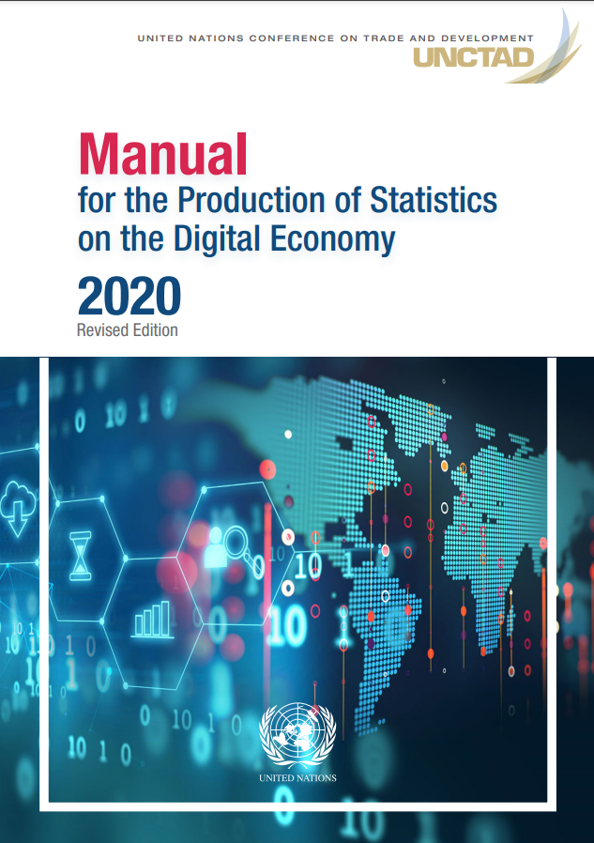
Consensus building in digital economy measurement
UNCTAD Working Group on E-commerce and Digital Economy (WG-ECDE)
Forum for members to work together to:
  share experiences
  learn about international efforts on digital economy measurement
  agree standards
  determine research priorities
WG-ECDE contributed to preparation of the UNCTAD Manual

Slide 7
Technical assistance in digital economy measurement
Drive to help countries implement the Manual
Self-paced online training course
  4 weeks/20 hours:
    Conceptual framework for measuring the digital economy
    Cooperation and coordination in digital economy statistics
    Statistical standards for indicators
    Data sources and collection methods
    Model questions and questionnaires
    Designing ICT business surveys and processing data
  First implementation as part of the Pacific Digital Economy Programme, in Feb/Mar 2022
  Physical regional courses (when possible)
Tailored technical assistance to meet specific needs
  Kenya, Palestine – preparing business ICT use surveys
  India, Costa Rica, Thailand surveys on digitally delivered trade
  Cambodia has requested assistance on e-commerce measurement
Funding
How to apply: send a written request to the SG of UNCTAD via your mission in Geneva (sgo@unctad.org).
Notes:
For HH surveys ITU can provide assistance (incl. on HH aspects of e-commerce)

